Slide 1
Bootstrap 5

Slide 2
Breakpoints. Sufixos de tamanhos
Breakpoint | Class infix | Dimensions
X-Small | None | <576px
Small | sm | ≥576px
Medium | md | ≥768px
Large | lg | ≥992px
Extra large | xl | ≥1200px
Extra extra large | xxl | ≥1400px

Slide 3
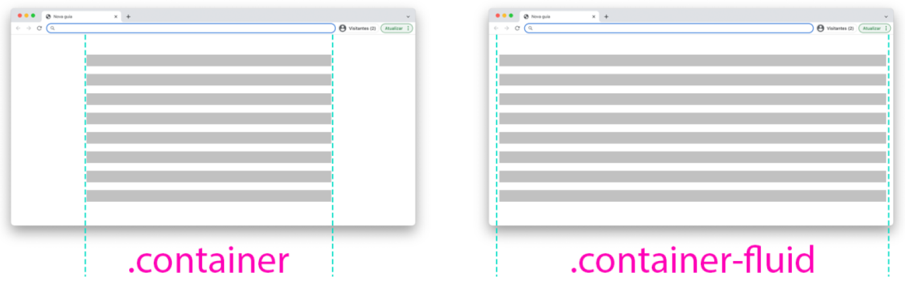
Containers

Slide 4
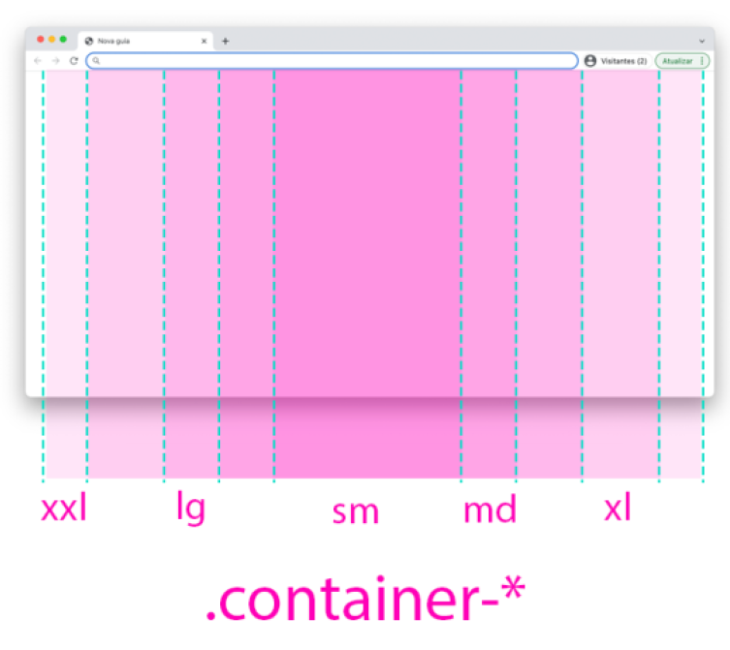
Containers

Slide 5
Principais tags de contêiners.
 | Extra small <576px | Small ≥576px | Medium ≥768px | Large ≥992px | X-Large ≥1200px | XX-Large ≥1400px
.container | 100% | 540px | 720px | 960px | 1140px | 1320px
.container-sm | 100% | 540px | 720px | 960px | 1140px | 1320px
.container-md | 100% | 100% | 720px | 960px | 1140px | 1320px
.container-lg | 100% | 100% | 100% | 960px | 1140px | 1320px
.container-xl | 100% | 100% | 100% | 100% | 1140px | 1320px
.container-xxl | 100% | 100% | 100% | 100% | 100% | 1320px
.container-fluid | 100% | 100% | 100% | 100% | 100% | 100%

Slide 6
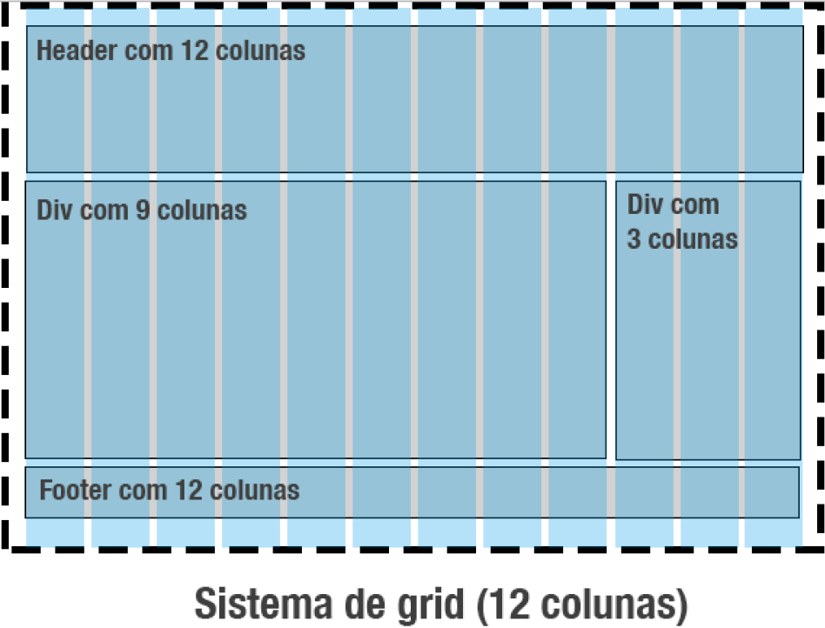
Divisão em 12 colunas. Sistema de Grid

Slide 7
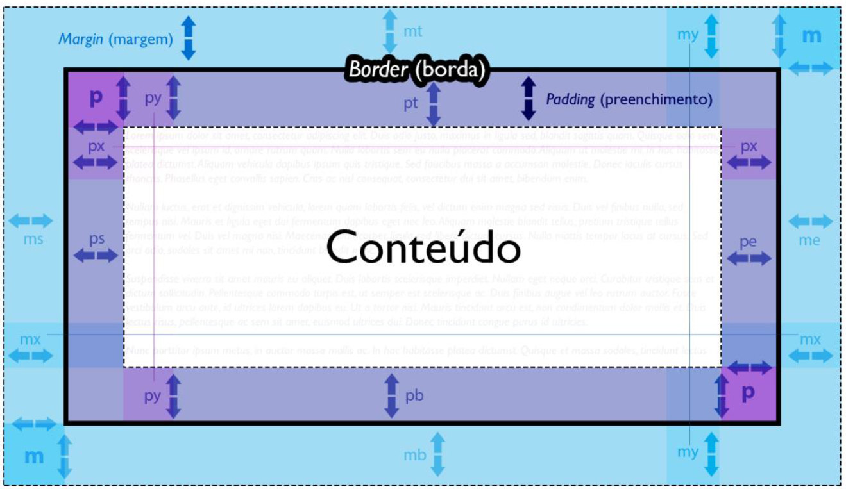
Margem e preenchimento

Slide 9
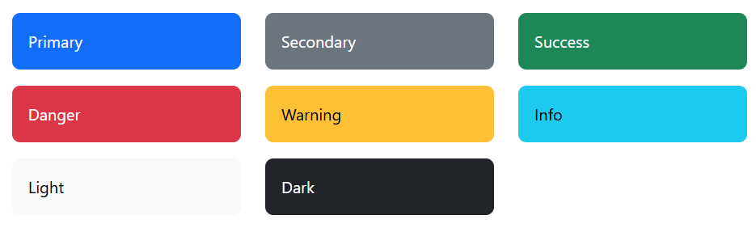
Cores

